Slide 1
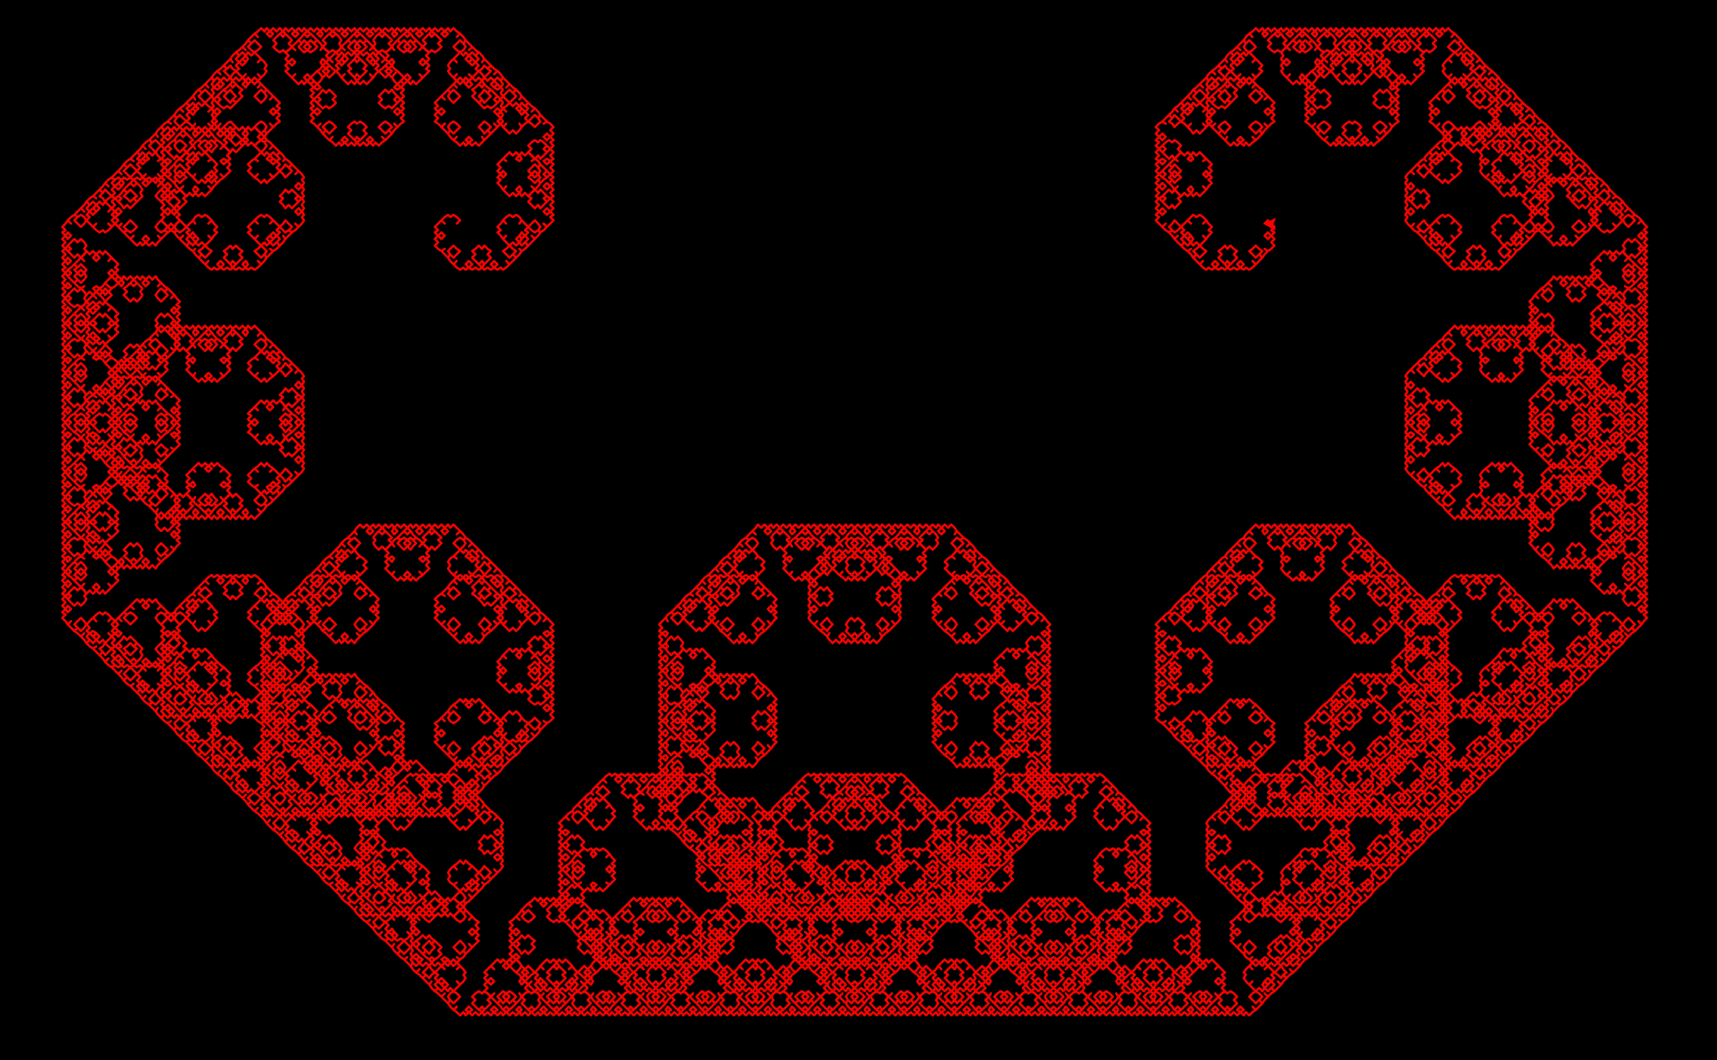
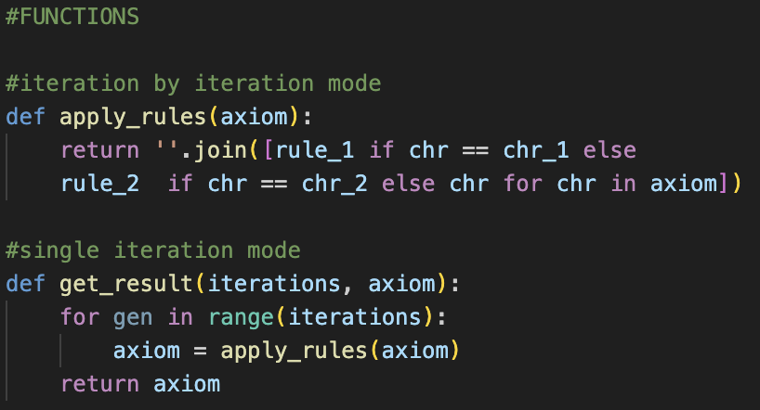
L-systems and Fractals
Aiden Vance

Slide 2
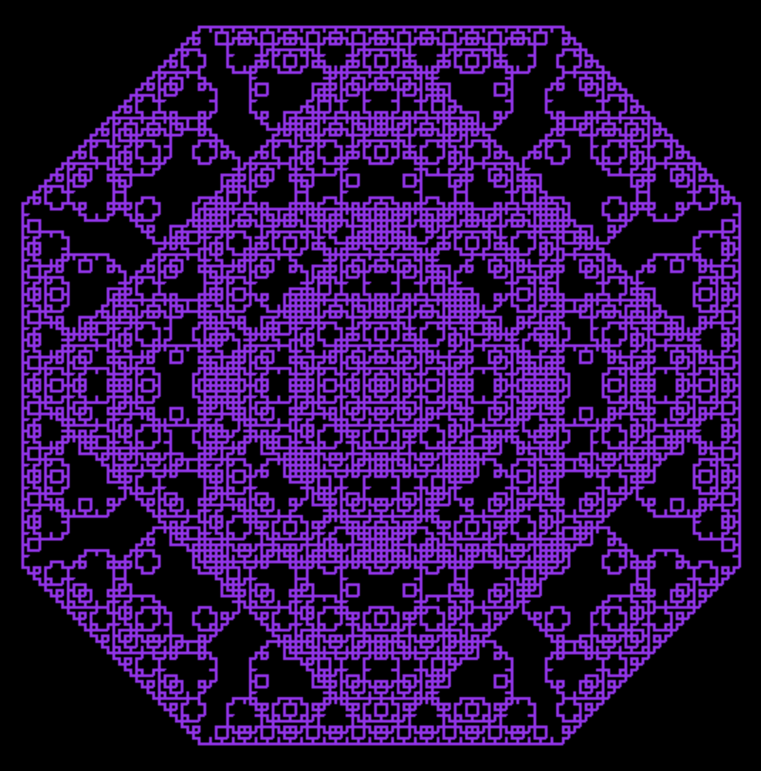
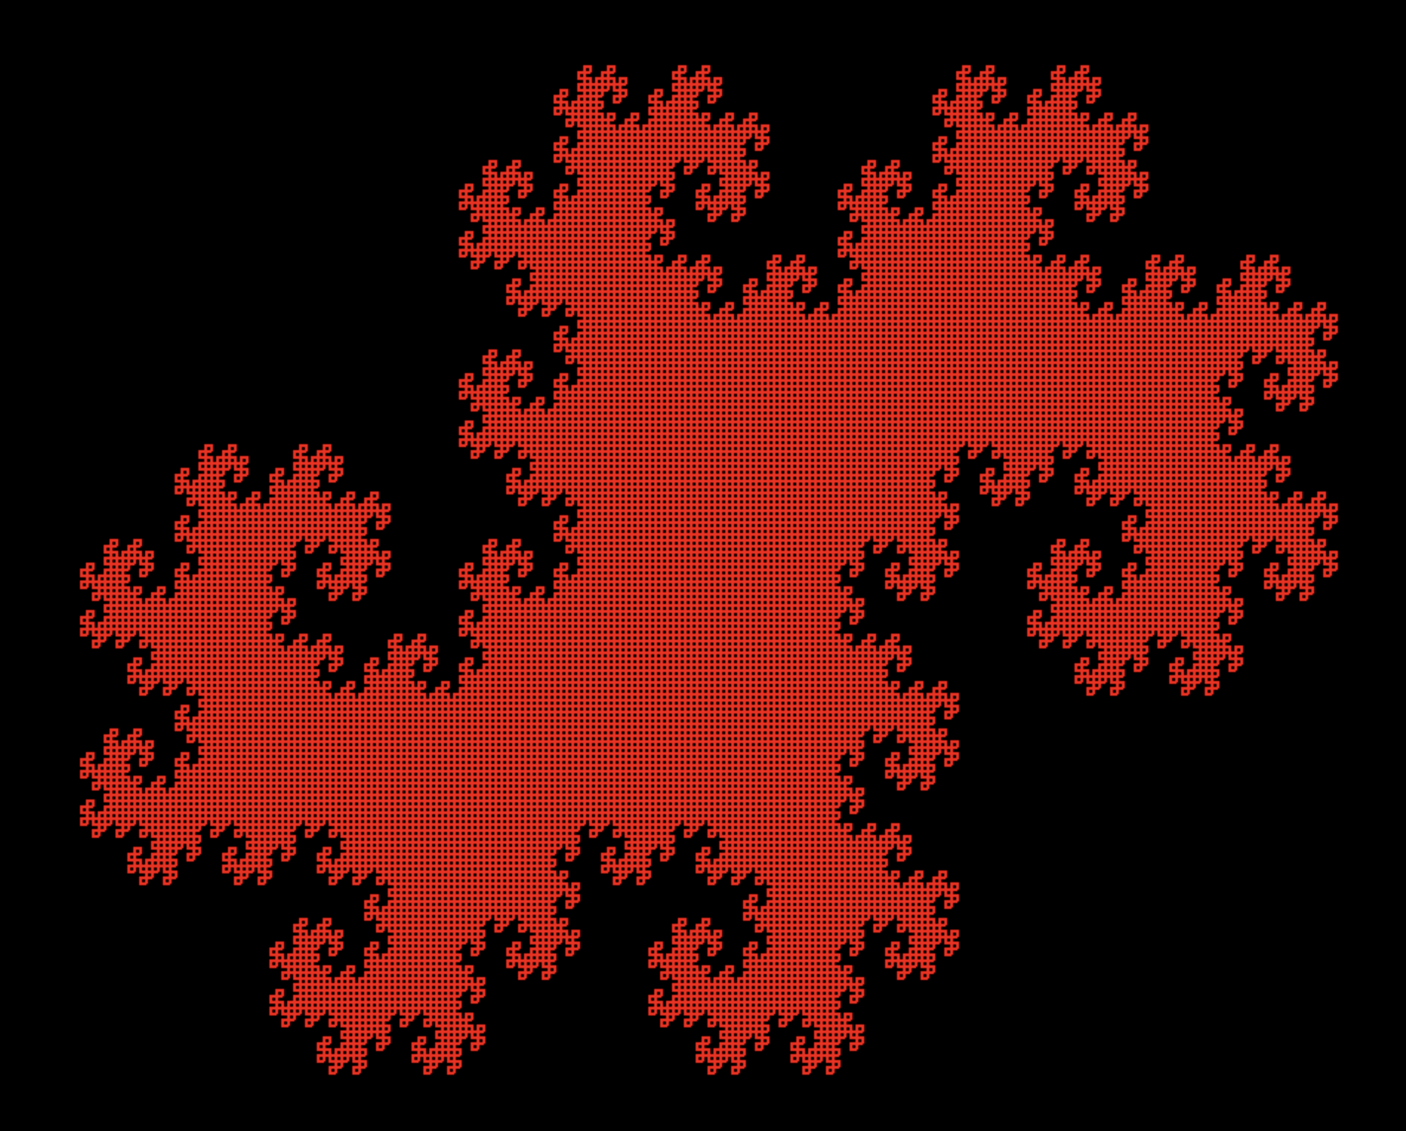
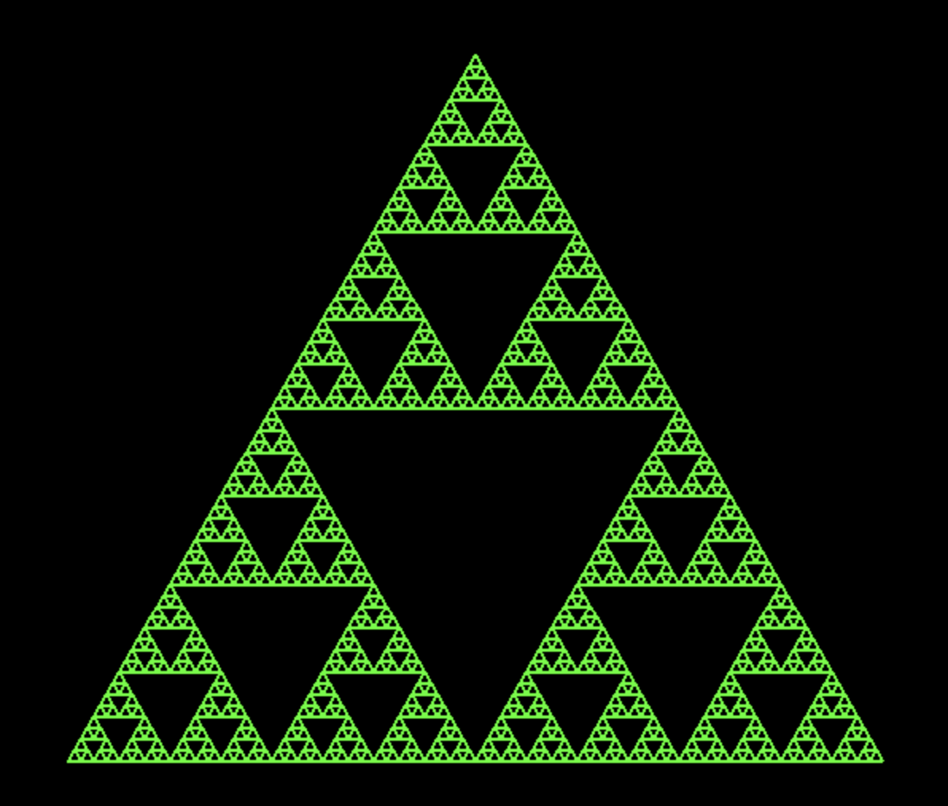
Introduction
I’ve been working on this project since early December
It has developed from a simple terminal based fractal generator to a program with a full user interface
I’ve learned so much about fractals, pygame, turtle, and much more

Slide 3
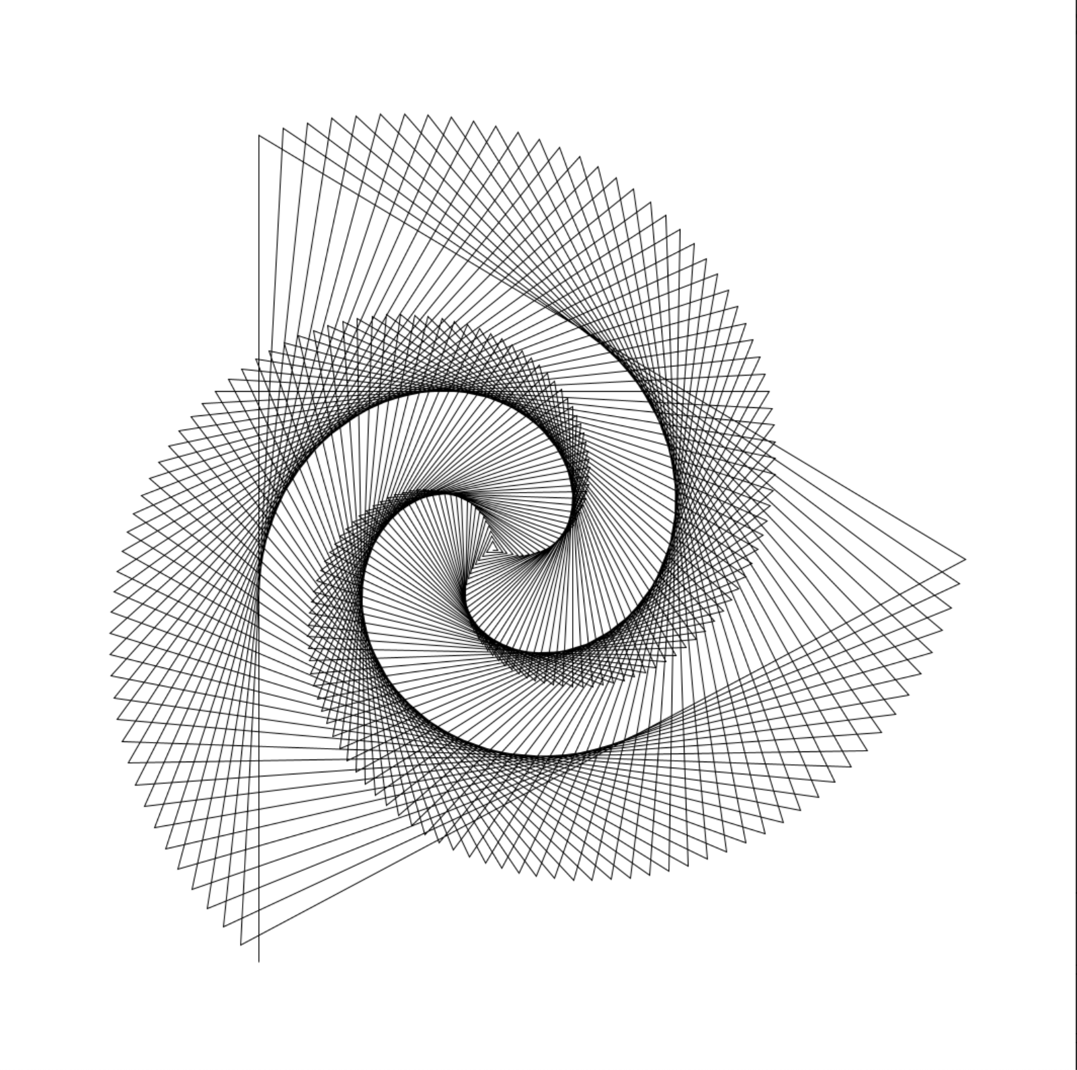
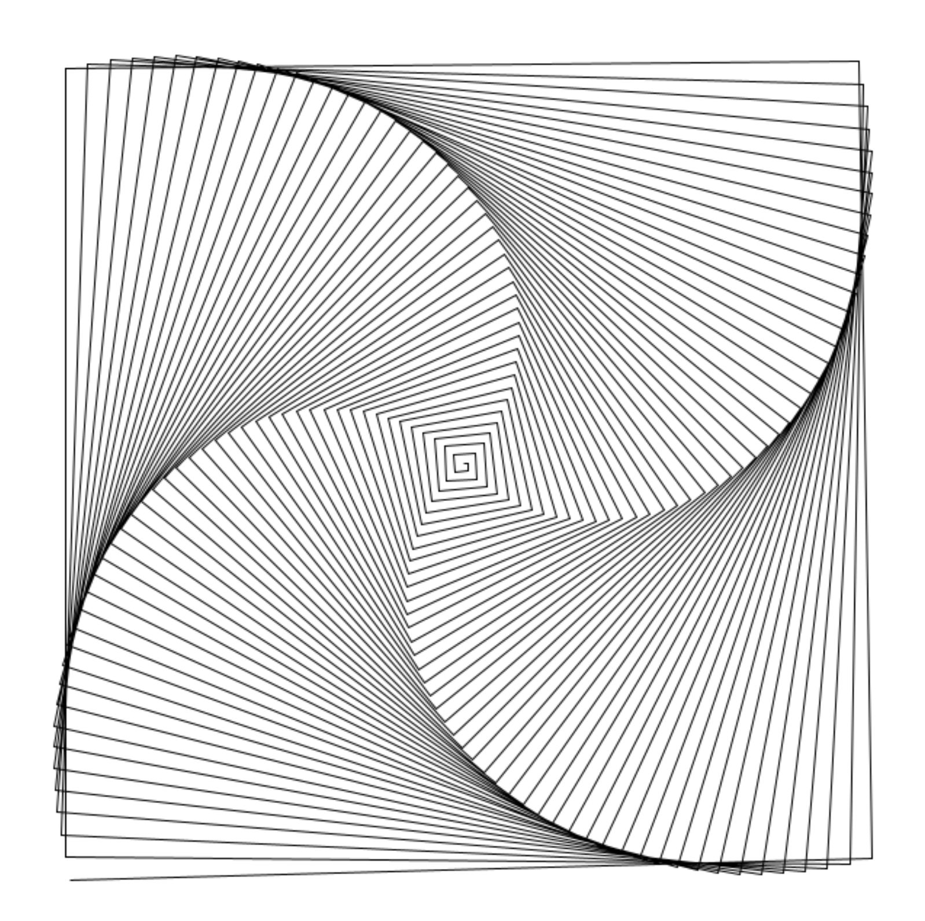
My Inspiration
I finished my coursework for the year and began searching for more to do
I found this thing called ‘Generative Art’ using Python’s Turtle module
I began learning how to use turtle
This eventually developed into generating fractals

Slide 4
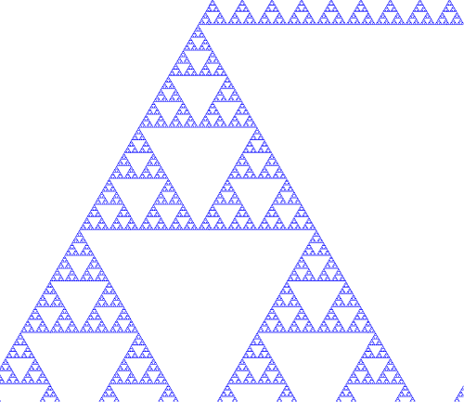
What Are Fractals?
A fractal is a shape that is infinitely complex
You could zoom in on this shape and never stop seeing new parts.

Slide 5
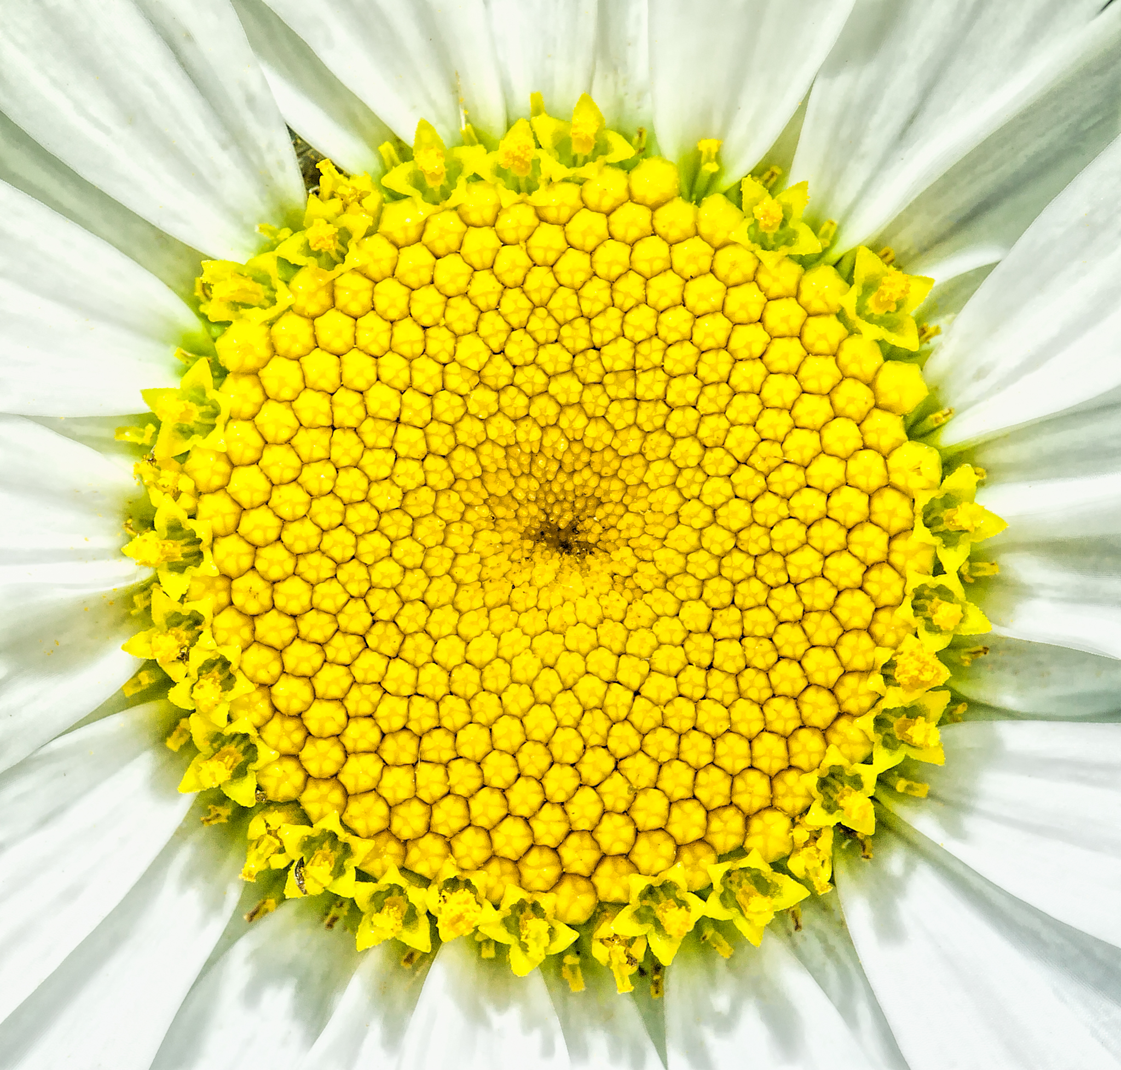
Some Examples Of Fractals
Fractals appear not only in math but in nature as well
These can appear in flowers, plants, leaves, trees, and so much more

Slide 6
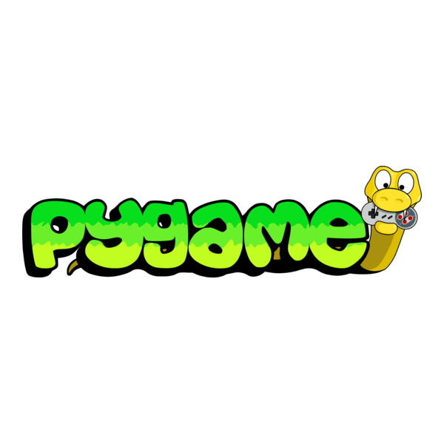
Tools And Technologies
I initially used turtle to create the graphics
I later used pygame to create a user interface
I switched to completely using pygame because of the difficulties with using turtle and pygame at the same time

Slide 7
How Does It Work?
L-system
Axiom: A
Character 1: A
Character 2: B
Rule 1: A -> AB
Rule 2: B -> A
Output
A
AB
ABA
ABAAB
ABAABABA
ABAABABAABAAB
ABAABABAABAABABAABABA
ABAABABAABAABABAABABAABAABABAABAAB
The program utilizes something called a Lindenmayer, or L-System
This iteratively rewrites strings that correspond to lines that generate a fractal.
These are simplified, straight line versions of famous fractals

Slide 8
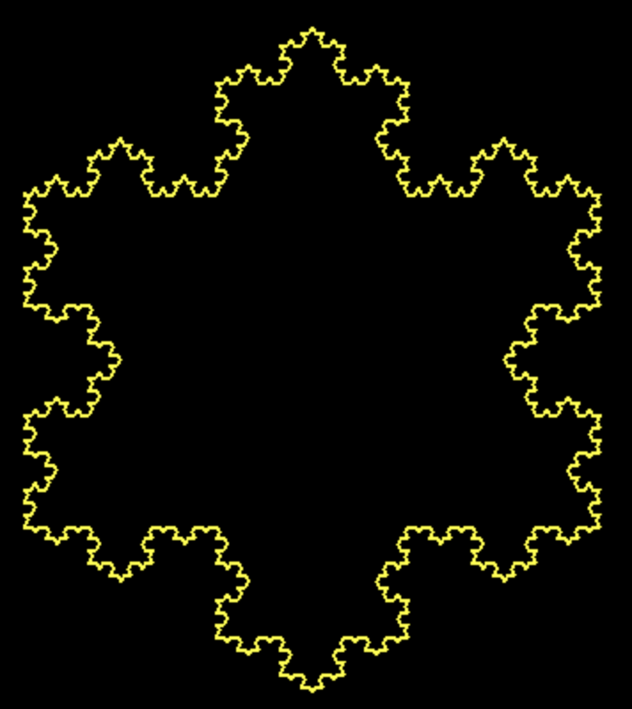

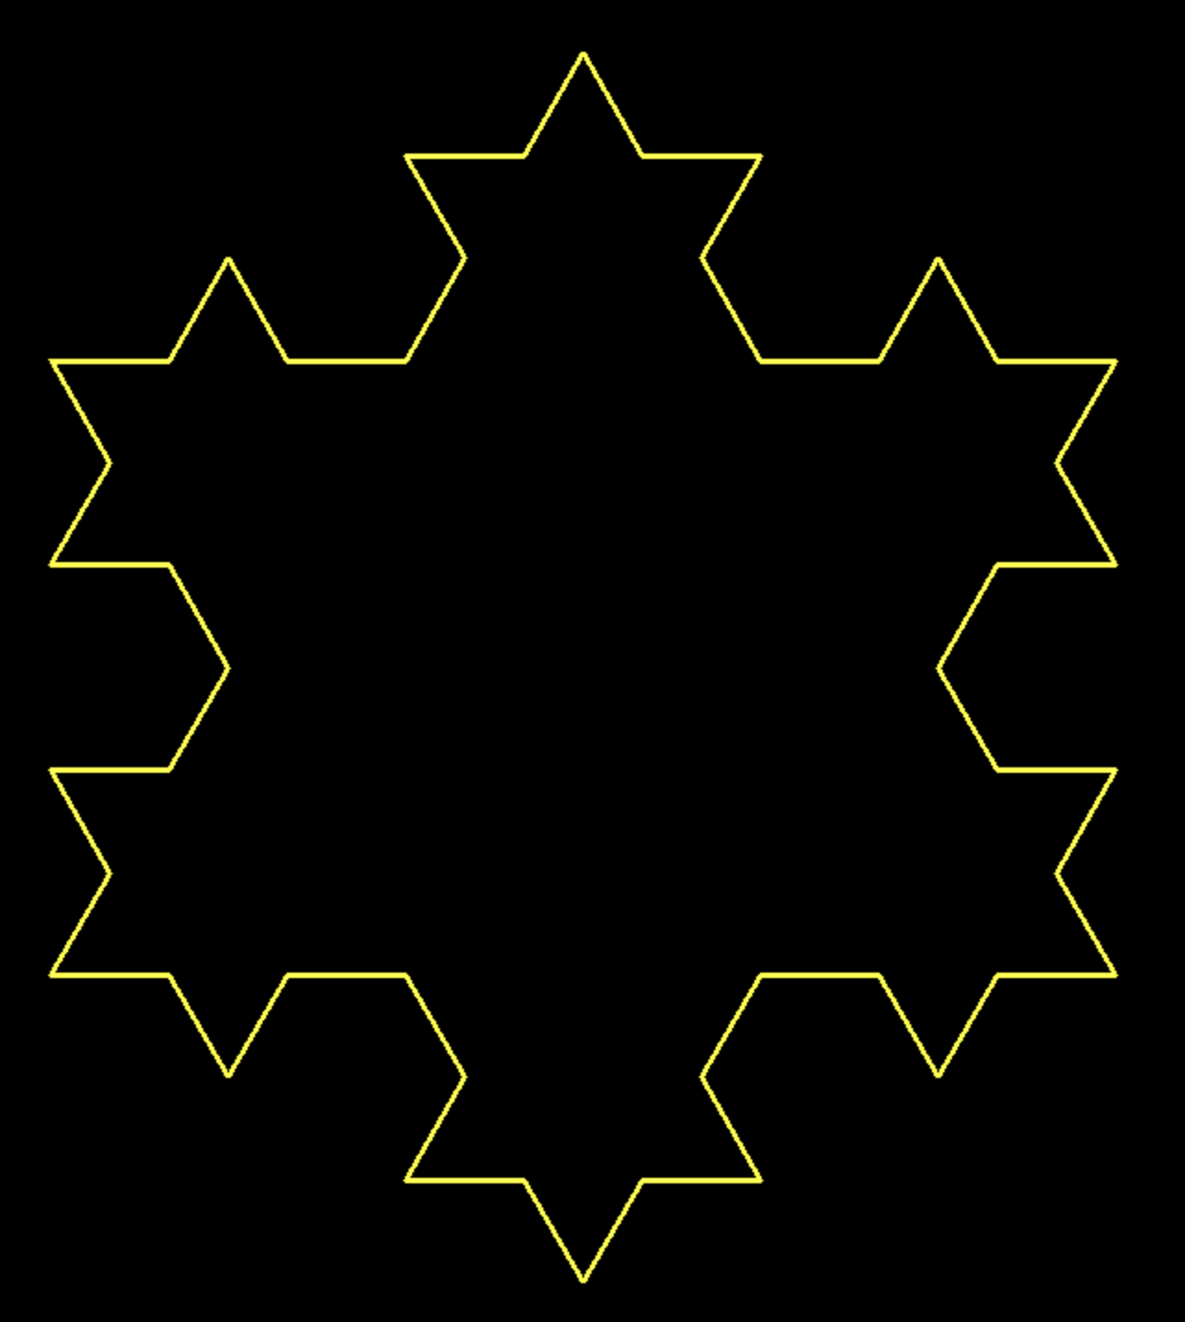


Koch Snowflake
Axiom: F++F++F
Character 1: F
Rule 1: F -> F-F++F-F
Translations:
‘F’ = move forward
‘+’ = turn left
‘-’ = turn right
Axiom: F++F++F
Axiom: F-F++F-F-F-F++F-F++F-F++F-F-F-F++F-F-F-F++F-F-F-F++F-F++F-F++F-F-F-F++F-F++F-F++F-F-F-F++F-F++F-F++F-F-F-F++F-F-F-F++F-F-F-F++F-F++F-F++F-F-F-F++F-F-F-F++F-F-F-F++F-F++F-F++F-F-F-F++F-F-F-F++F-F-F-F++F-F++F-F++F-F-F-F++F-F++F-F++F-F-F-F++F-F++F-F++F-F-F-F++F-F-F-F++F-F-F-F++F-F++F-F++F-F-F-F++F-F++F-F++F-F-F-F++F-F++F-F++F-F-F-F++F-F-F-F++F-F-F-F++F-F++F-F++F-F-F-F++F-F++F-F++F-F-F-F++F-F++F-F++F-F-F-F++F-F-F-F++F-F-F-F++F-F++F-F++F-F-F-F++F-F-F-F++F-F-F-F++F-F++F-F++F-F-F-F++F-F-F-F++F-F-F-F++F-F++F-F++F-F-F-F++F-F++F-F++F-F-F-F++F-F++F-F++F-F-F-F++F-F-F-F++F-F-F-F++F-F++F-F++F-F-F-F++F-F++F-F++F-F-F-F++F-F++F-F++F-F-F-F++F-F-F-F++F-F-F-F++F-F++F-F++F-F-F-F++F-F++F-F++F-F-F-F++F-F++F-F++F-F-F-F++F-F-F-F++F-F-F-F++F-F++F-F++F-F-F-F++F-F-F-F++F-F-F-F++F-F++F-F++F-F-F-F++F-F-F-F++F-F-F-F++F-F++F-F++F-F-F-F++F-F++F-F++F-F-F-F++F-F++F-F++F-F-F-F++F-F-F-F++F-F-F-F++F-F++F-F++F-F-F-F++F-F++F-F++F-F-F-F++F-F++F-F++F-F-F-F++F-F-F-F++F-F-F-F++F-F++F-F++F-F-F-F++F-F++F-F++F-F-F-F++F-F++F-F++F-F-F-F++F-F-F-F++F-F-F-F++F-F++F-F++F-F-F-F++F-F-F-F++F-F-F-F++F-F++F-F++F-F-F-F++F-F-F-F++F-F-F-F++F-F++F-F++F-F-F-F++F-F++F-F++F-F-F-F++F-F++F-F++F-F-F-F++F-F-F-F++F-F-F-F++F-F++F-F++F-F-F-F++F-F++F-F++F-F-F-F++F-F++F-F++F-F-F-F++F-F-F-F++F-F-F-F++F-F++F-F++F-F-F-F++F-F++F-F++F-F-F-F++F-F++F-F++F-F-F-F++F-F-F-F++F-F-F-F++F-F++F-F++F-F-F-F++F-F-F-F++F-F-F-F++F-F++F-F++F-F-F-F++F-F-F-F++F-F-F-F++F-F++F-F++F-F-F-F++F-F++F-F++F-F-F-F++F-F++F-F++F-F-F-F++F-F-F-F++F-F-F-F++F-F++F-F++F-F-F-F++F-F++F-F++F-F-F-F++F-F++F-F++F-F-F-F++F-F-F-F++F-F-F-F++F-F++F-F++F-F-F-F++F-F++F-F++F-F-F-F++F-F++F-F++F-F-F-F++F-F-F-F++F-F-F-F++F-F++F-F++F-F-F-F++F-F-F-F++F-F-F-F++F-F++F-F++F-F-F-F++F-F-F-F++F-F-F-F++F-F++F-F++F-F-F-F++F-F++F-F++F-F-F-F++F-F++F-F++F-F-F-F++F-F-F-F++F-F-F-F++F-F++F-F++F-F-F-F++F-F
Axiom: F-F++F-F++F-F++F-F++F-F++F-F
Axiom: F-F++F-F-F-F++F-F++F-F++F-F-F-F++F-F++F-F++F-F-F-F++F-F++F-F++F-F-F-F++F-F++F-F++F-F-F-F++F-F++F-F++F-F-F-F++F-F
Axiom: F-F++F-F-F-F++F-F++F-F++F-F-F-F++F-F-F-F++F-F-F-F++F-F++F-F++F-F-F-F++F-F++F-F++F-F-F-F++F-F++F-F++F-F-F-F++F-F-F-F++F-F-F-F++F-F++F-F++F-F-F-F++F-F++F-F++F-F-F-F++F-F++F-F++F-F-F-F++F-F-F-F++F-F-F-F++F-F++F-F++F-F-F-F++F-F++F-F++F-F-F-F++F-F++F-F++F-F-F-F++F-F-F-F++F-F-F-F++F-F++F-F++F-F-F-F++F-F++F-F++F-F-F-F++F-F++F-F++F-F-F-F++F-F-F-F++F-F-F-F++F-F++F-F++F-F-F-F++F-F++F-F++F-F-F-F++F-F++F-F++F-F-F-F++F-F-F-F++F-F-F-F++F-F++F-F++F-F-F-F++F-F

Slide 9
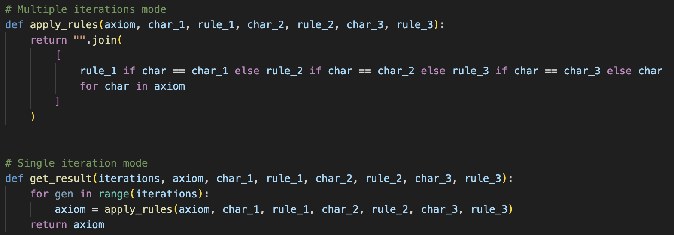
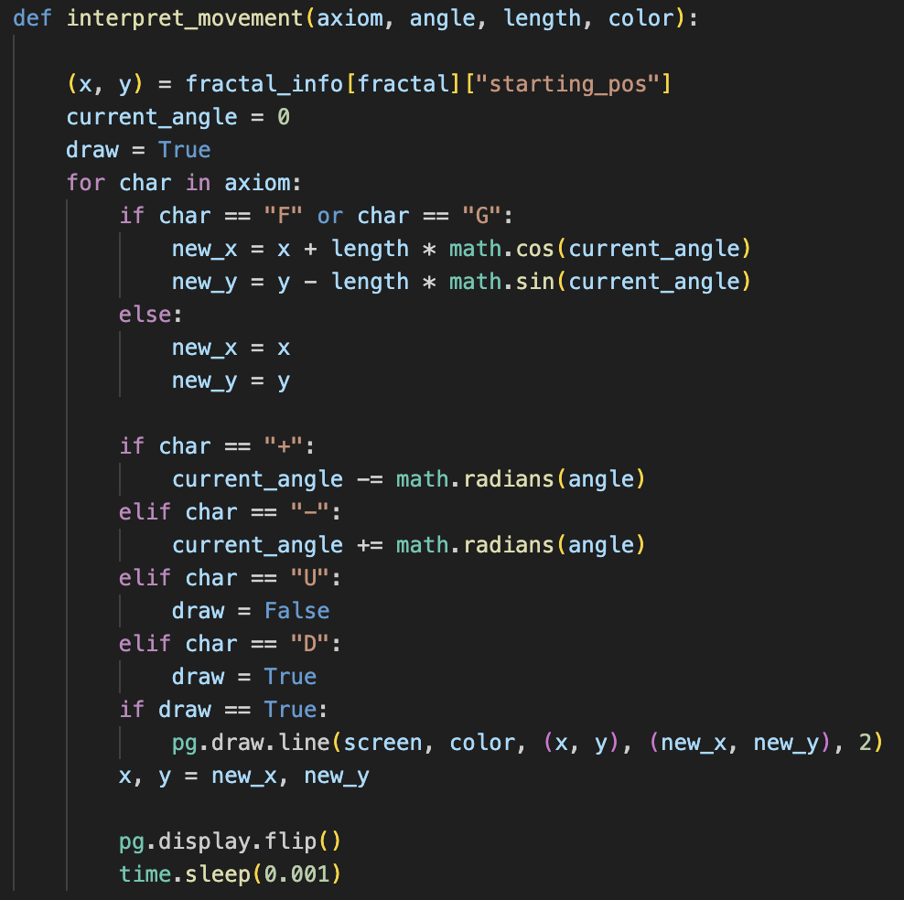
Code Highlights
If this character, replace with this string

Slide 10
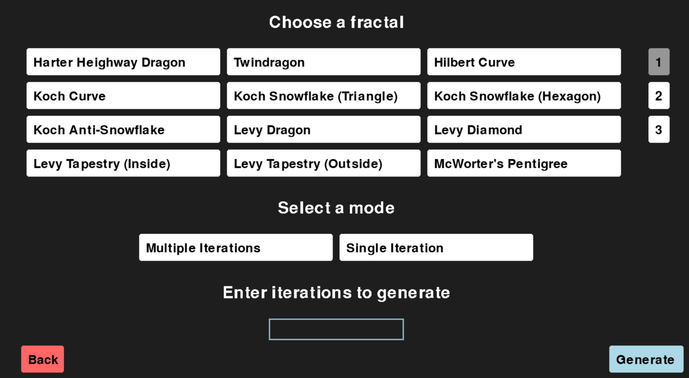
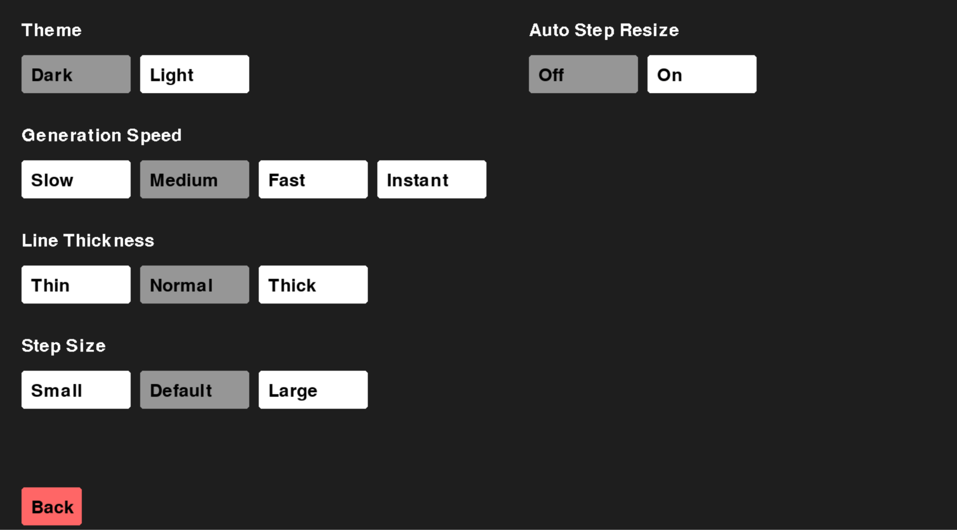
Live Demo

Slide 11
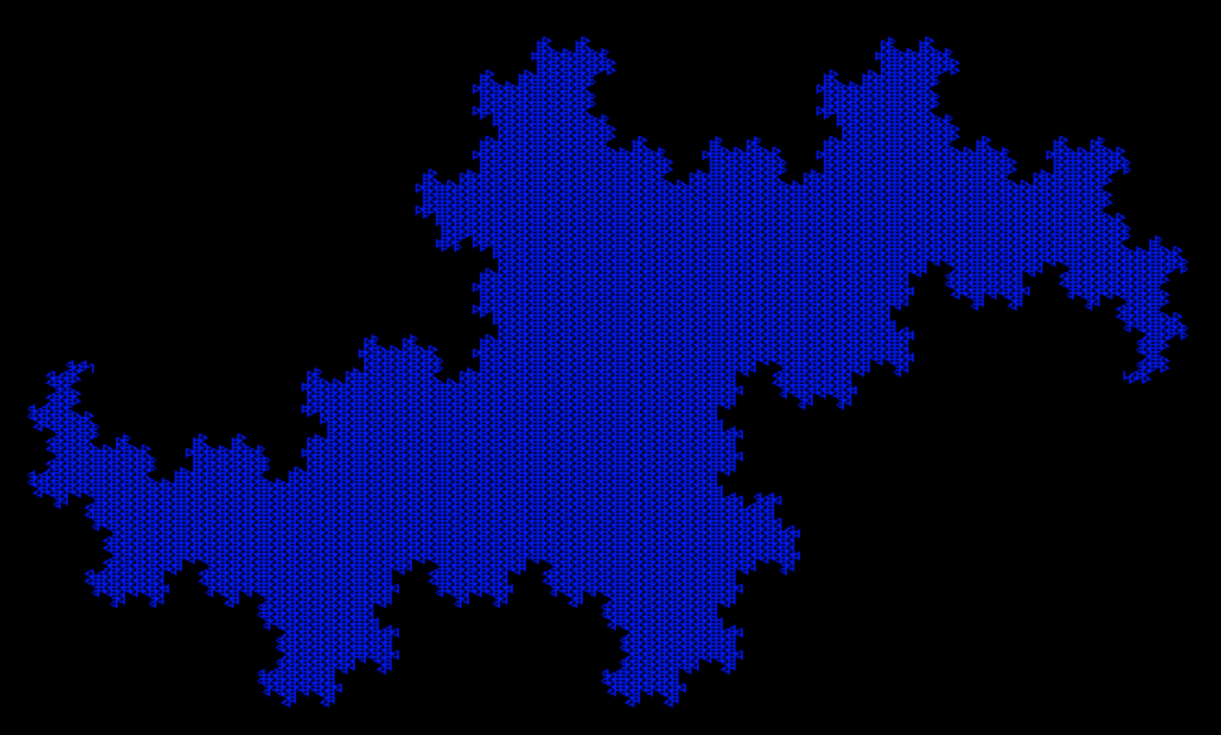
Challenges
I tried to use pygame with turtle
These two modules were not designed to interact with each other
I fixed this problem by transitioning away from turtle, completely using pygame to generate the visuals

Slide 12
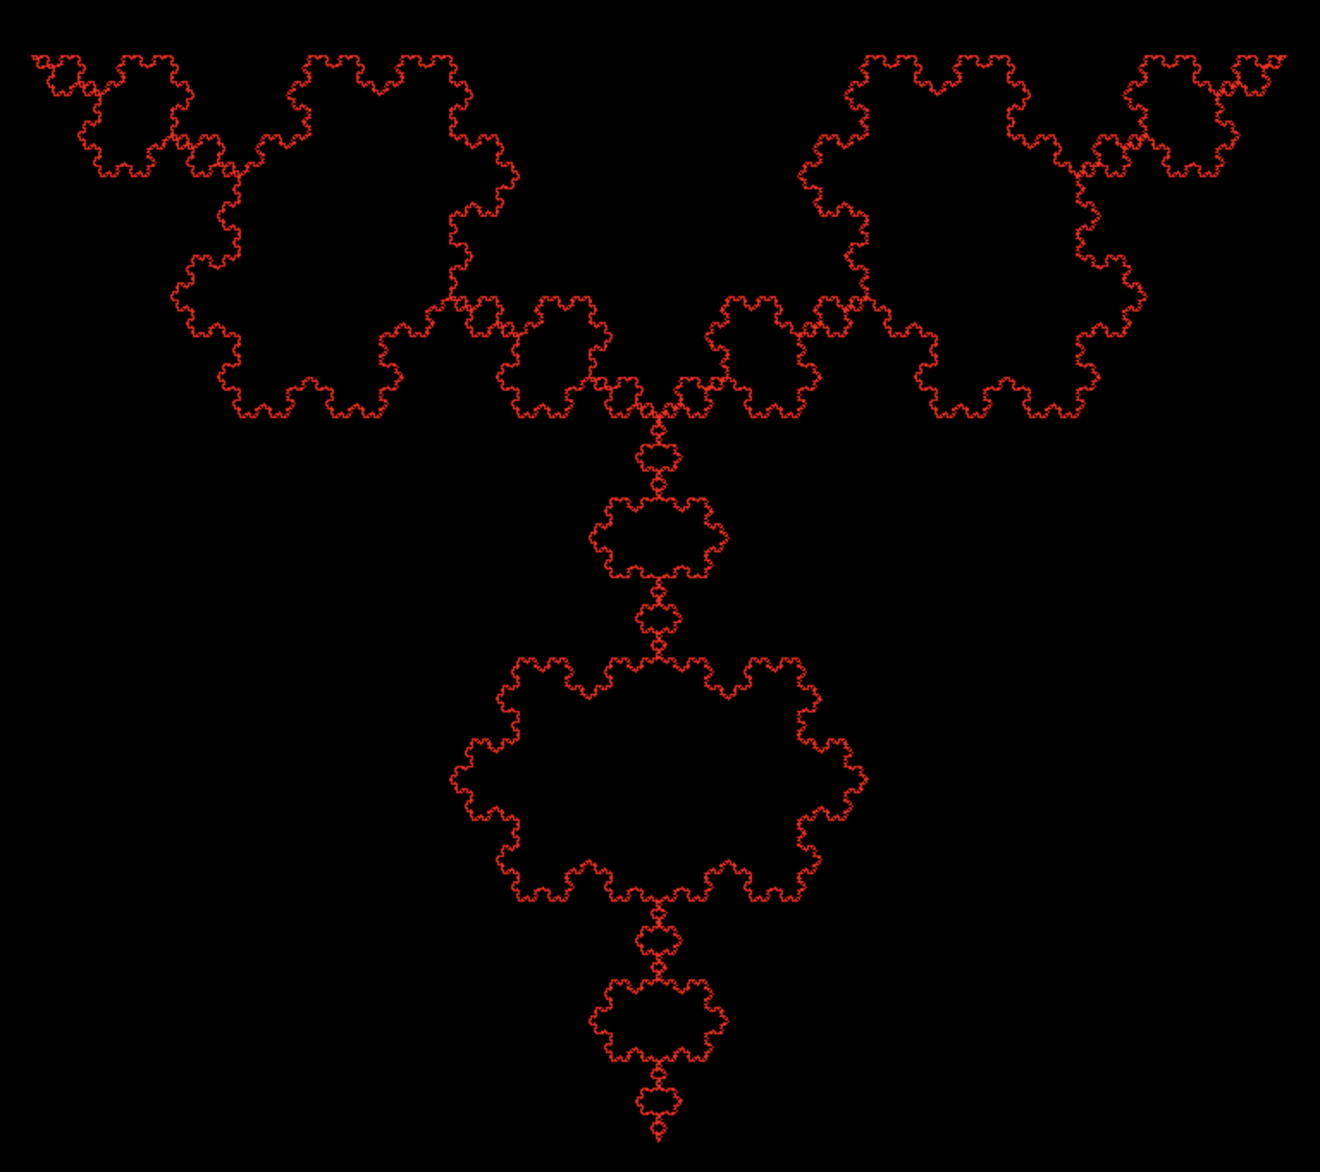
What I Learned
I learned many things over the course of the development of this project
I learned how to utilize classes to group functions, how to use turtle and pygame, and how to use a rewrite system

Slide 13
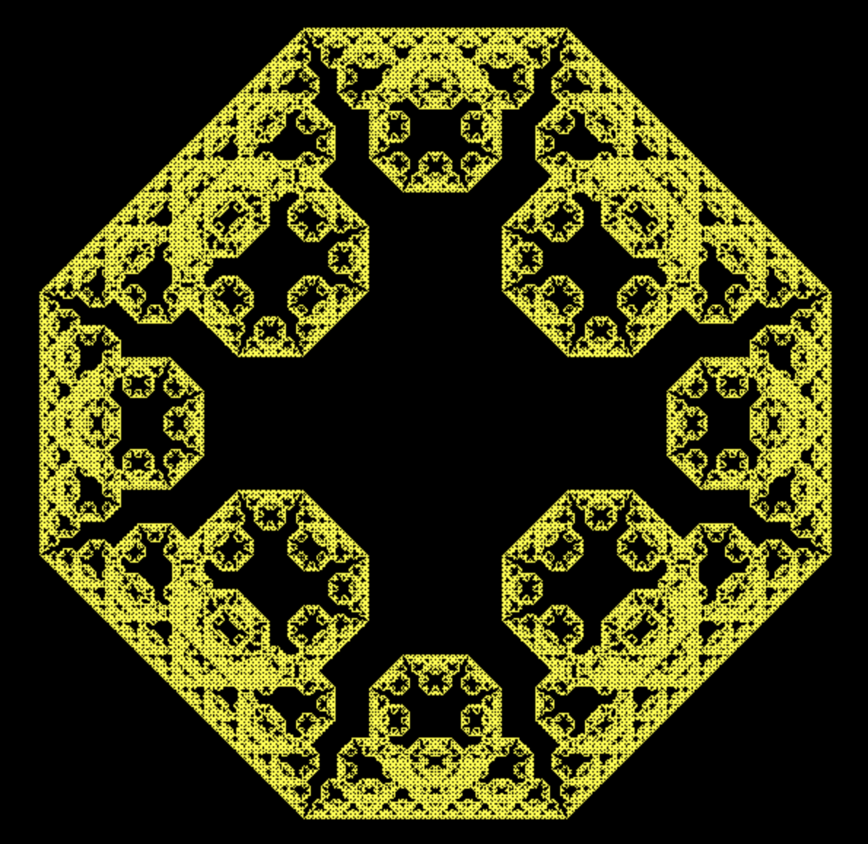
Possible Improvements
One major possible improvement is simply better structuring of the code
Just because it works doesn’t mean it’s a good program.
There is much room for improvement

Slide 14
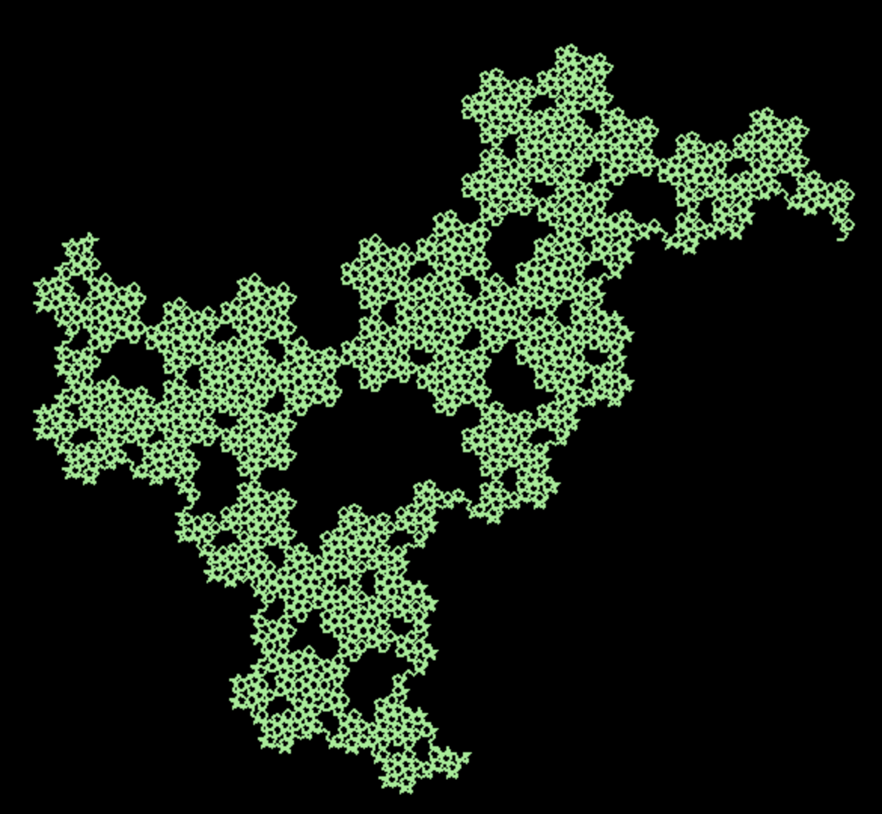
Reflection
This has been a great learning experience for me
This is just the beginning of my journey I plan to take throughout high school and into college

Slide 15
Questions?

Slide 16
Thank You!

